Slide 1
2026-2027 Academic Year: The Shift from Modular to Semester System
ALPER KALYONCU
VICE CHAIR

Slide 2
TUPEX
%40
FALL & SPRING
%60
ASSESSMENT

Slide 3
SEMESTR
FALL % 40
16 WEEKS
SPRING % 60
16 WEEKS

Slide 5
MIDTERM EXAMS (20%)+ (20%)
Fall Term / Midterm 1 Spring Term / Midterm 1
Fall Term / Midterm 2 Spring Term / Midterm 2
USE OF ENGLISH | 25%
READING | 25%
LISTENING | 25%
WRITING | 25%
USE OF ENGLISH | 25%
READING | 25%
LISTENING | 15%
SPEAKING | 10%
WRITING | 25%
USE OF ENGLISH | 25%
READING | 25%
LISTENING | 15%
SPEAKING | 10%
WRITING | 25%
USE OF ENGLISH | 25%
READING | 25%
LISTENING | 15%
PRESENTATION | 10%
WRITING | 25%

Slide 6

TEACHER ASSESSMENT – TA (10%)
Quizzes
Class Participation
Assignments (Homework)
Online Assignments
Portfolio

Slide 7
FINAL (%50)
USE OF ENGLISH | 25%
READING | 25%
LISTENING | 25%
WRITING | 25%

Slide 8
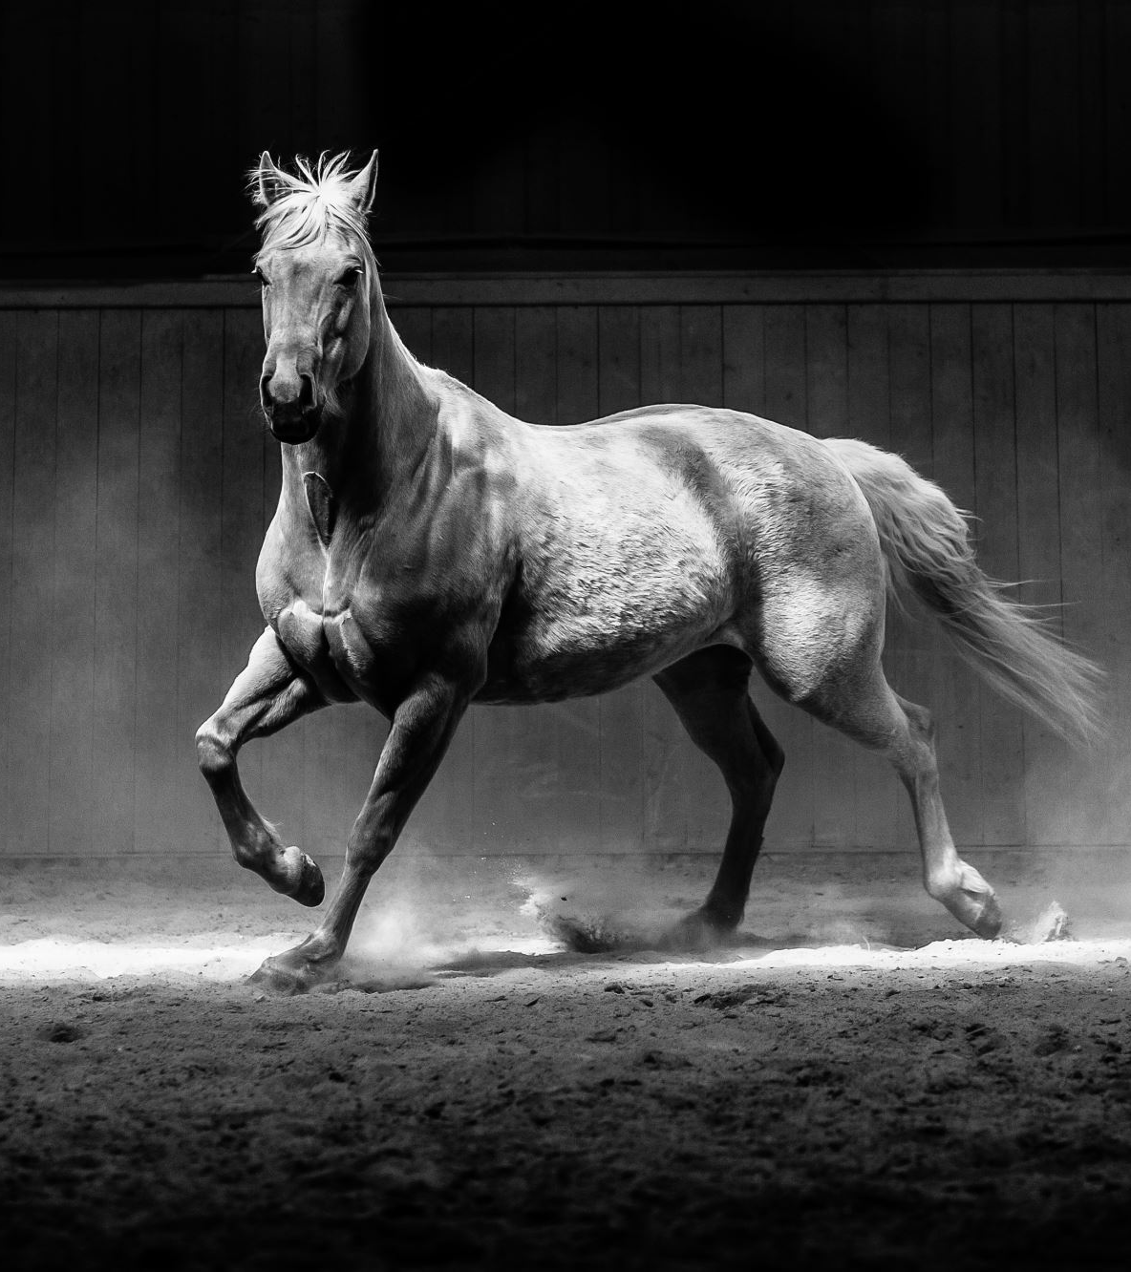
What is new?
Minimum of 70% attendance is mandatory.
Otherwise they lose the right to take the year-end Final exam.
TUPEX Threshold: Students must score at least 60 points on the Placement exam to take TUPEX.
AI-supplemented Grading
The +85 average TUPEX exemption rule applies to all students.

Slide 9
TUPEX
(TOROS UNIVERSITY PROFICIENCY EXAM)
TEST | READING 1 | 15 PTS
 | READING 2 | 15 PTS
 | WHILE LISTENING | 10 PTS
WRITTEN | NOTETAKING | 15 PTS
 | WRITING | 35 PTS
VERBAL | SPEAKING | 10 PTS

Slide 10
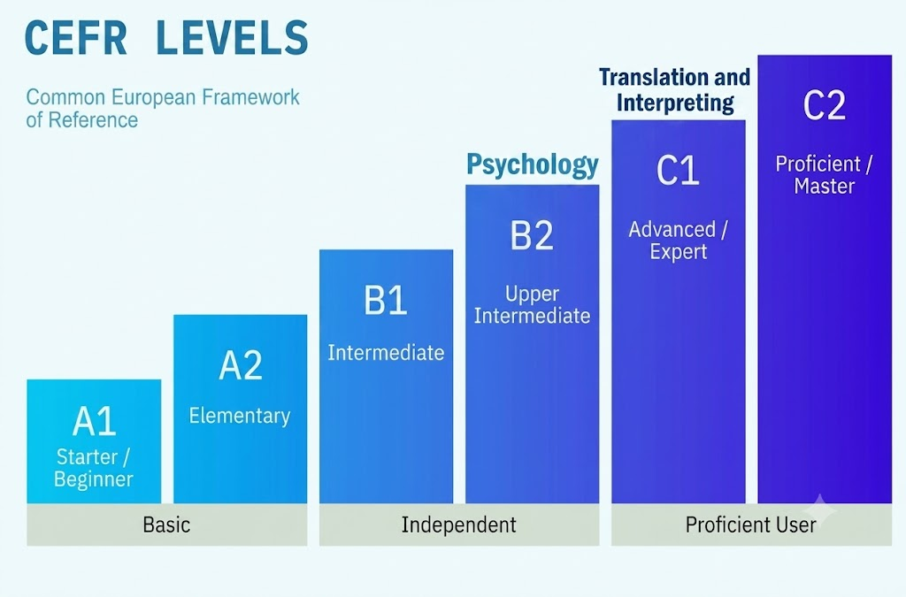
Levels

Slide 11
CLASSES and LEVELS
 | BELFAST (PSYCHOLOGY) | CAMBRIDGE (TRANSLATION)
FALL TERM | A1, A2 | B1, B1+
SPRING TERM | B1, B2 | B2, C1
SUMMER SCHOOL | B1, B2 | B2, C1

Slide 12
Organization Chart
ADMINISTRATIVE OFFICE /ARCHIVE
FACULTY ACADEMIC ENGLISH UNIT
(FAE)
DISTANCE EDUCATION UNIT
CURRICULUM AND MATERIAL PRODUCTION OFFICE
TESTING OFFICE
FAE COORDINATOR
VICE-CHAIR/ PROFESSIONAL DEVELOPMENT
DIRECTOR
VICE-CHAIR / QUALITY DIRECTOR
EDUCATION COORDINATOR
LISTENING / SPEAKING COORDINATOR
USE OF ENGLISH COORDINATOR
READING COORDINATOR
WRITING COORDINATOR
FACULTY LECTURERS
FOREIGN STUDENT REPRESENTATIVE
LECTURERS
DISABILITY SUPPORT UNIT

Slide 13
Areas for Development
Invıgılatıon performance
Onlıne Teachıng platforms

Slide 14
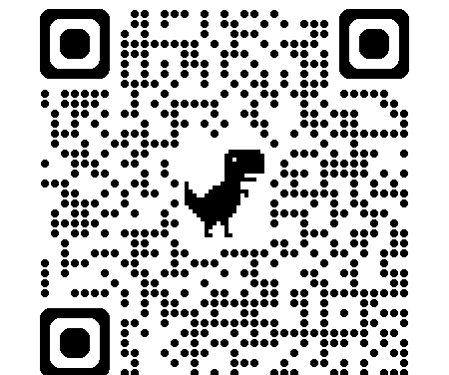


Slide 15
AKADEMİK TAKVİM /GÜZ yarıyılı
GÜZ YARIYILI
İngilizce Seviye Tespit Sınavı | 10 EYLÜL PERŞEMBE 2026
İngilizce Yeterlik Sınavı | 11 EYLÜL CUMA 2026
Yabancı Diller Bölümü Açılış ve Oryantasyon Programı | 21 EYLÜL PAZARTESİ 2026
Yabancı Diller Bölümü Güz Yarıyılı Ders Başlangıcı | 21 EYLÜL PAZARTESİ 2026
Güz Yarıyıl Final Sınavı | 08 OCAK CUMA 2027
Yabancı Diller Bölümü Yarı Yıl Tatili | 11 OCAK PAZARTESİ 2027

Slide 16
AKADEMİK TAKVİM /BAHAR yarıyılı
BAHAR YARIYILI
Yabancı Diller Bölümü Bahar Yarıyılı Ders Başlangıcı | 25 OCAK PAZARTESİ 2027
Bahar Yarıyıl Final Sınavı | 21 MAYIS CUMA 2027
İngilizce Yeterlik Sınavı: Yazılı | 31 MAYIS PAZARTESİ 2027
İngilizce Yeterlik Sınavı: Sözlü | 01 HAZİRAN SALI 2027
İngilizce Yeterlik Sınavı Sonuç Açıklama | 04 HAZİRAN CUMA 2027

Slide 17

QUESTIONS and ANSWERS
Thank you

